Slide 1
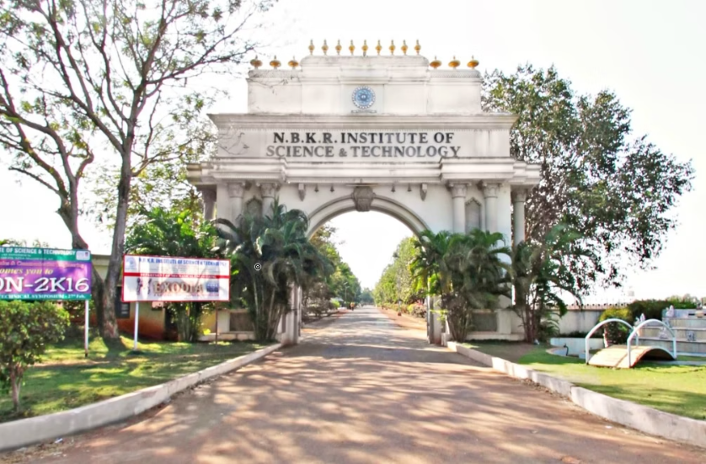
NBKR Institute Of Science and Technology
Bus Seat Booking System in C
RAKESH 24KB1A05U7
PARAMESHVARMA 24KB1A05BA
SATYA PRAMOD 24KB1A05AZ
RAGHURAM 24KB1AO5Q9

Slide 2
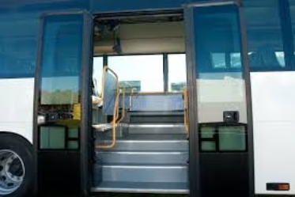



INTRODUCTION
WHY C,DSA
output screen
OBJECTIVE
ALGORITHM
Lessons Learnt
User Interaction Flow
Conclusion

Slide 3

OBJECTIVE
Bus Seat Booking System using seat map in 2D array , able to book/cancel seats and save booking in file.

Slide 4

Why C and DSA?
C Language
Foundation of programming, direct memory control
2D Arrays
Represent seating layout efficiently
Algorithms
Book, cancel, save seats efficiently
Problem-solving
Learn optimized coding techniques

Slide 5





Algorithm Used
Initialize seats
Set all seats as Available (A)
Display status
Show current seat map
Menu options
Book Seat: A to B
Cancel Seat: B to A
Save to file
Exit
Validate input
Check row and column range
Save updates
Update seat map accordingly

Slide 6
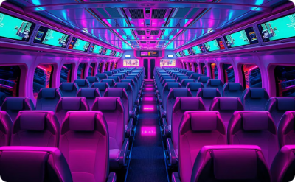
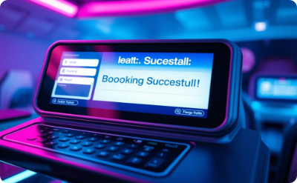
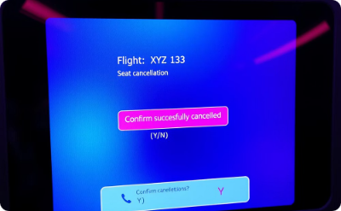
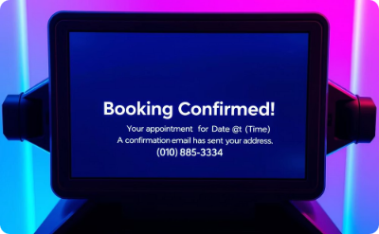
Visuals of System
Seat Map
Booking
Cancellation
Save Confirmation
Initial seat availability display
Seat booking process
Cancel booked seat
Bookings saved to file

Slide 7
User Interaction Flow
Display seat map
Choose menu option
Input seat position
Confirm booking or cancellation
Save or exit

Slide 8
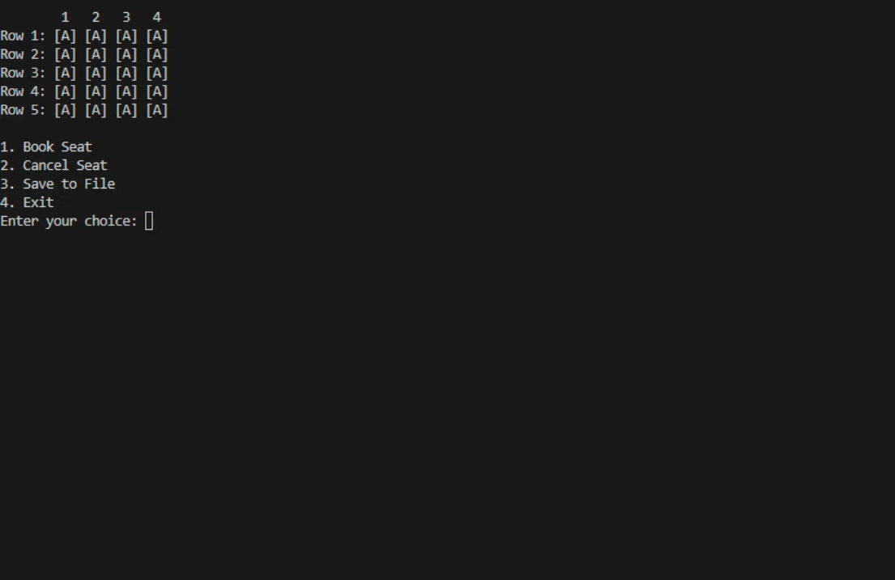
OUTPUT:
It is The interface of program while executing.
As we can see they are four choice.
choice are:
Book Seat
Cancel Seat
Save to File
Exit

Slide 9
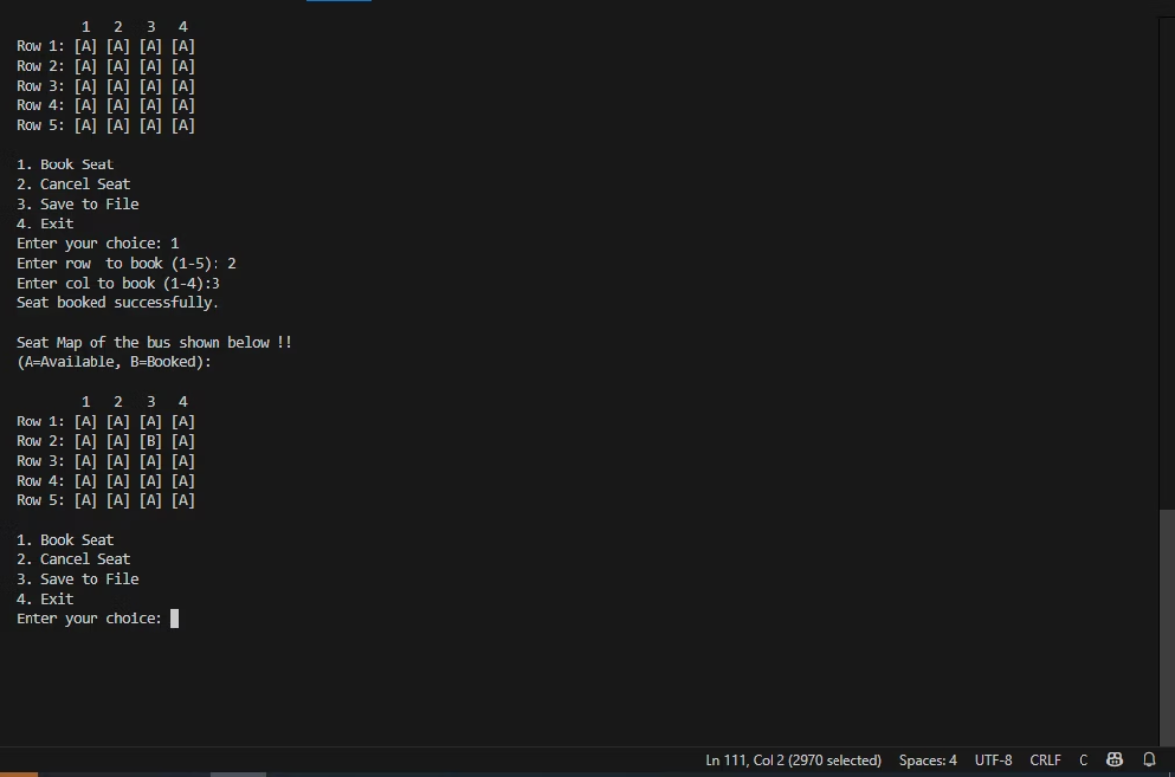
For to book seat user need to type 1 click ENTER.
After User need give coordinates of Seat.

Slide 10
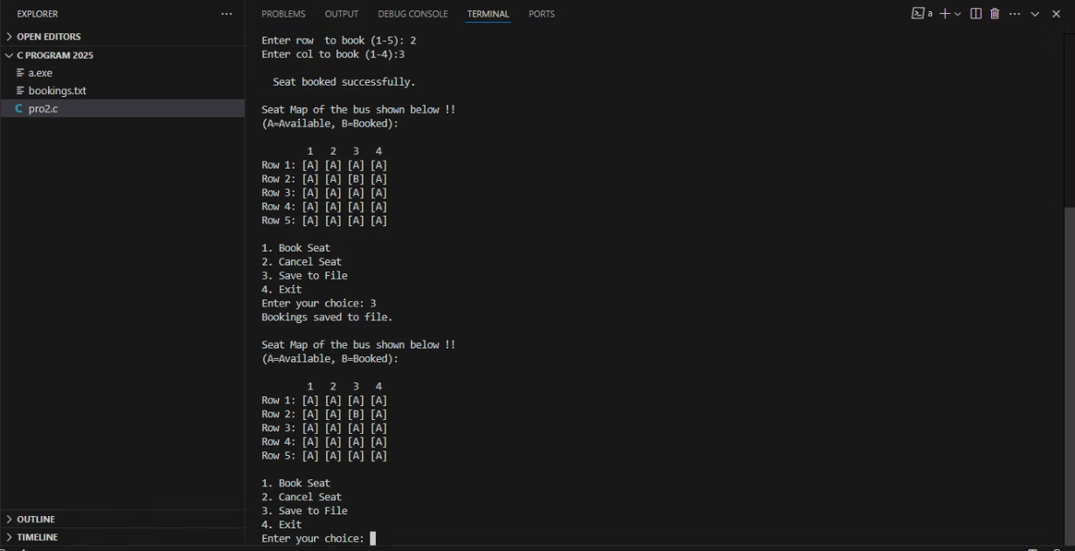
User need to type 3 and click ENTER to save his/her booking in secondary storage.
It create a text file in secondary storage.

Slide 11
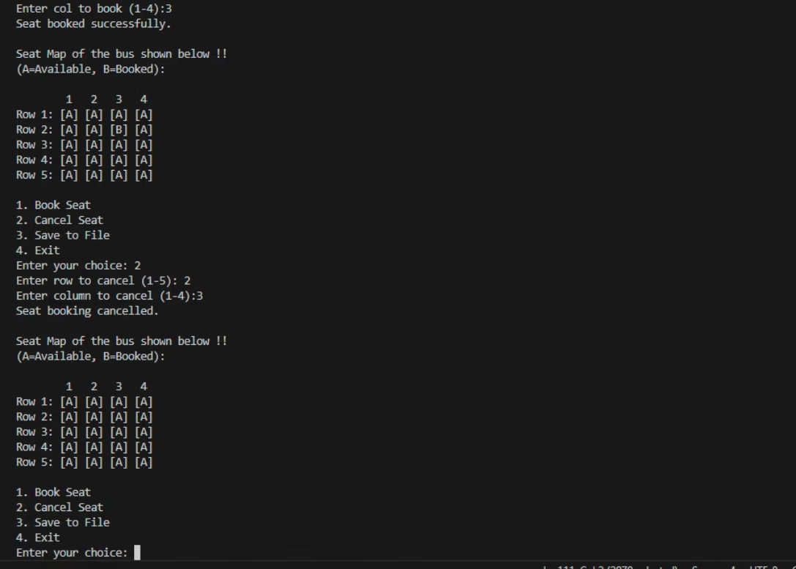
If user need to cancel then he/she need to type 2 and click ENTER.
After need to give exact coordinates of seat which he/she previously used for booking.

Slide 12
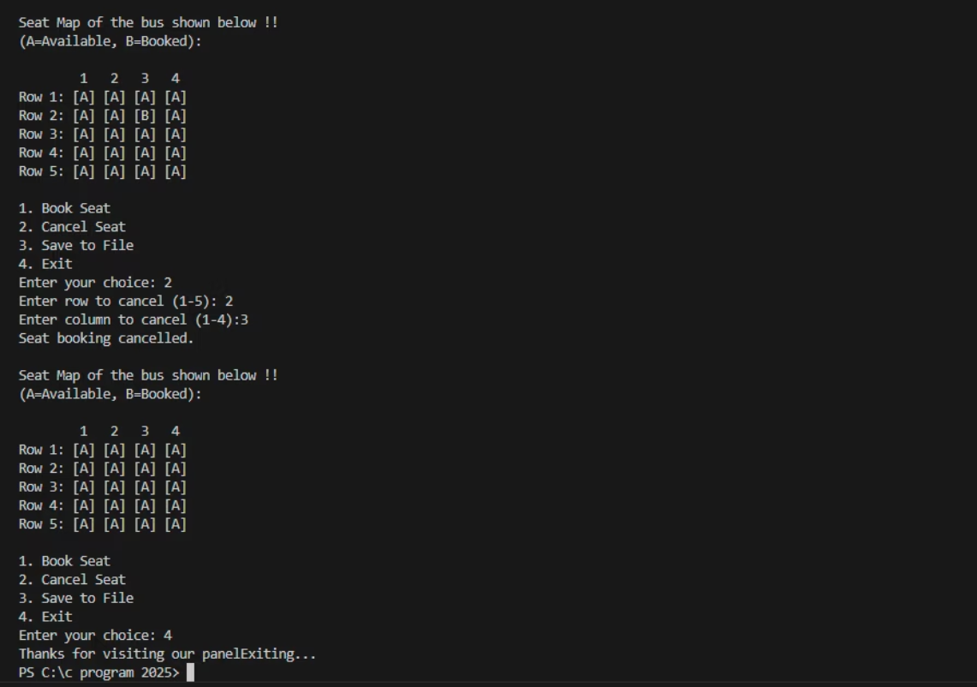
If User want exit the program then he/she need type 4 and click ENTER.
Then it wish the user before exiting.

Slide 13

Lessons Learnt
User input handling
Menu-driven program design
File handling
Save data permanently
Error checking
Handle invalid input and bookings
Data management
Use arrays and file operations

Slide 14

Conclusion:
Understand C basics
Apply problem-solving
Arrays, file handling, algorithms
Menu-driven program design

